Slide 1


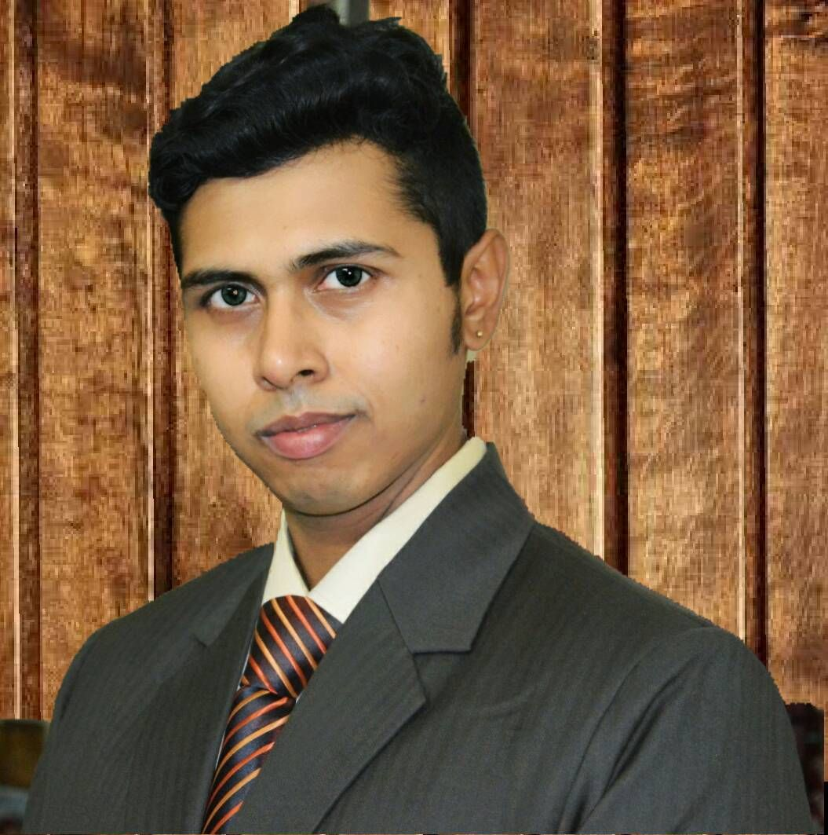



About Me
Ritam Mukherjee
Your Photo
Having 12+ years of experience in Development of Real time enterprise grade highly scalable product.
At present working as Tech Lead and Associate Architect of a Leading Product Based IT company’s R&D Division.
Conducted 50+ training both online & offline mode & 20+ corporate training inside & outside organization where employed over 12+ years.
I am part of a dynamic group delivering high engagement, outcome-centric training for SimpliLearn
CERTIFICATION
EXPERIENCE
Notes:
Editing to be done by Faculty: Please update your Name, Photo and Key achievements.
Delivery: Walkthrough the learners on yourself such as achievements, key skills and experience.

Slide 2







A Leading Global Online Training Company
9 Years
digital-skills training
1000+
Employees
Our mission is to help professionals around the world acquire the skills they need to succeed in today’s digital economy.
1 Million
digital-skills training in over 150 countries
2,000
Industry-grade trainers
Notes:
Let’s revive the journey of SimpliLearn for few mins.
In this era of digital economy, SimpliLearn helps professionals to acquire skills that they need to achieve. It has been almost a decade for SimpliLearn, training digitally 1 Million learners over 150 countries.

Slide 3










Our Journey
SEP 2009
Modest start as a
“Project management” blog
JUN 2015
Simplilearn acquired digital marketing training leader Market Motive
MAR 2011
5 more categories added
along with PMP
JUN 2012
20,000 professionals
across 50+ countries
SEP2014
Largest certification
training provider
FEB 2016
Ranked 8th in the most influential global
education brands on LinkedIn
2019
Leading global LIVE online training company
Notes:
SimpliLearn started its Journey with a Project Management Blog in 2009 and now The World's Leading Professional training provider with a blended learning approach

Slide 4





Awards
Notes:
Now lets see some remarkable milestones that we have achieved in this short span of time and we primarily focus on our learners experience and the learning outcome

Slide 5
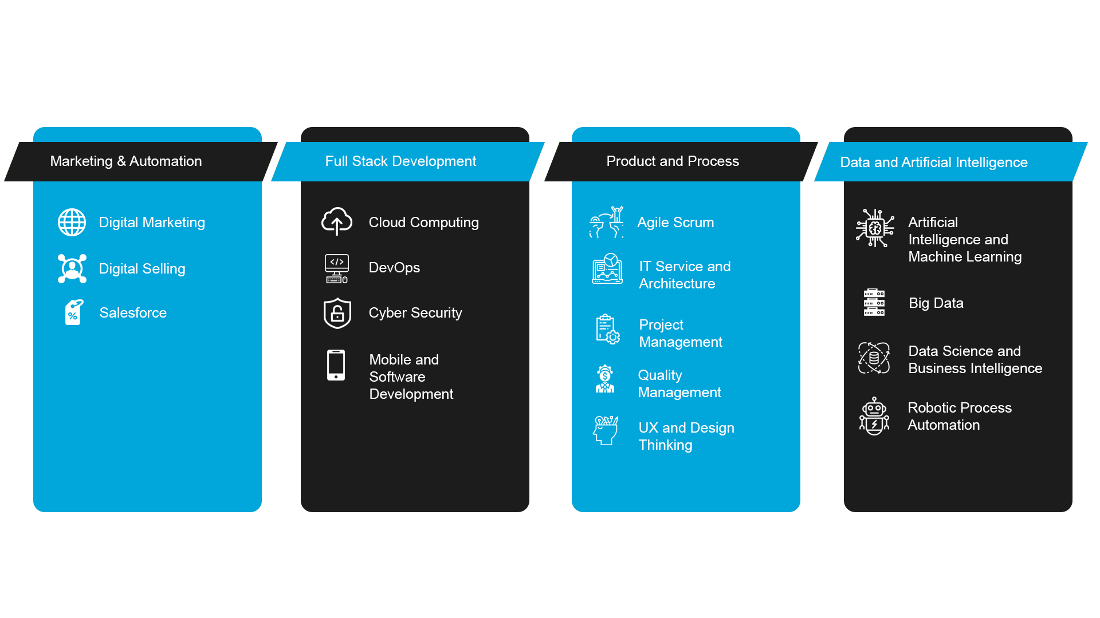
Our Categories
Notes:
Now that we have gone through SimpliLearn journey, it’s time to understand your journey and how you can pursue the career after this course. This slide is for your information to further understand what SimpliLearn offers as vast category of courses, and they are divided into 4 – Marketing & Automation, Full Stack Development, Product and Process and Data and Artificial Intelligence.
You may require any one or many courses in your career to get ahead.
Action: Visit, lms.simplilearn.com -> Move your cursor to All Courses -> Indicate the category and then talk about the course in one or two lines.

Slide 6




Your Journey
Completion Criteria
80%
Live virtual classroom course completion
Mobile On-the-Go Learning
Online Self-Guided Learning
Global Teaching Assistants
Assignments
Mentorship
60%
Simulation exam
Score, if applicable
+
Project submission and
Evaluation, if applicable
Training Anytime, Anywhere Access
Live Virtual Classrooms
Hands-on Labs
(If applicable)
Quizzes and Practices Tests
Project Work
(If applicable)
Certification
Notes:
Its time to know what you need to achieve the certificate in this (Course Name) Course.
Start your learning using Self-learning materials based on the topic that I would share for upcoming class.
Attend the Live class, understand the concepts and implement them on tools and applications provided or suggested.
If any questions during class hours, you can ask me, and I will there to address you.
Post class, you can raise questions on Community or tickets using Help & Support so that the Teaching Assistant can answer your questions.
You would need to complete project in the class on or before the last day and submit.
You can attend the mentoring classes on projects as per the schedule provided on LMS.
You are required to complete 80% Live Class, 1 project, and score 60% and above to unlock the certificate.

Slide 7

Blended Learning
Know your class
Introduce yourself (Name)
Years of experience
Your past experiences related to course
Notes:
Here we go on understanding you by sharing your Name, experience and any relevant projects that you have worked in your career.
Action: Set expectation based on the experience that you receive from the learners.

Slide 8















Online Classroom Ground Rules
Be on Time. You don't want to miss out on anything.
Have a doubt? Use the CHAT box
We have breaks every two hours. You deserve it!
Feedback form helps us understand how we can serve you better. Please fill it out at the end of every session.
You can reach out to
Help & Support or
Community forum for
any assistance
Notes:
As you know discipline is very important while delivering and understanding the class. So here you go with the following rules:
Please be on time so that we can start the session on time.
Your questions would be answered after the topic is over to ensure the flow of training is not distracted. Use the chat box to ask your questions and if needed you can ask to unmute so that you can speak on mic (preferred end of the session)
10 mins break after two hours of the training.
Feedback is important, as this helps us understand the change that I need to bring in for you to ensure you understand every bit of the training.
Post the training, you can connect using Community or raise ticket through Help & Support.

Slide 9

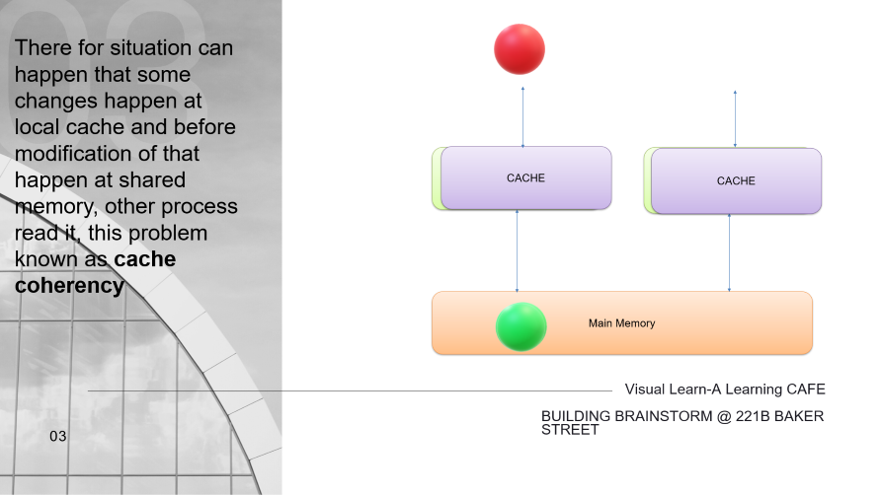
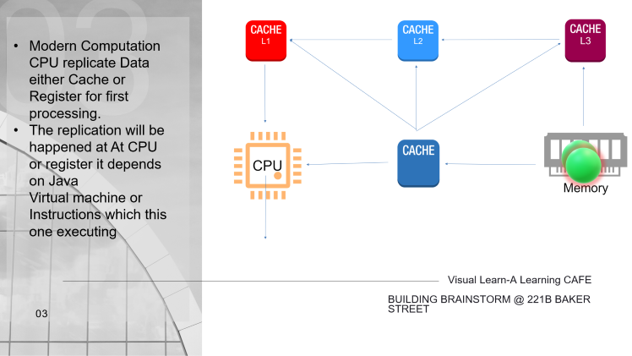
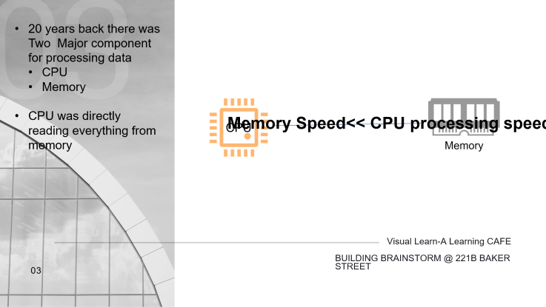
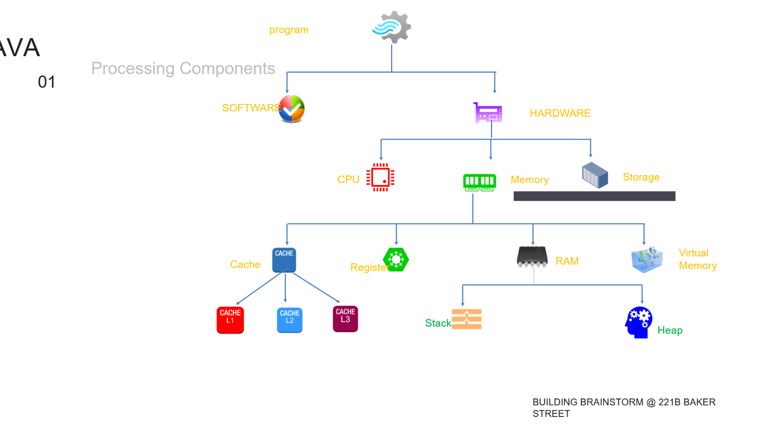
Concurrency In JAVA
Memory Model in Java
01
BUILDING BRAINSTORM @ 221B BAKER STREET
Email: visual.learn@gmail.com
Ph no: +91 8334949911.

Slide 10

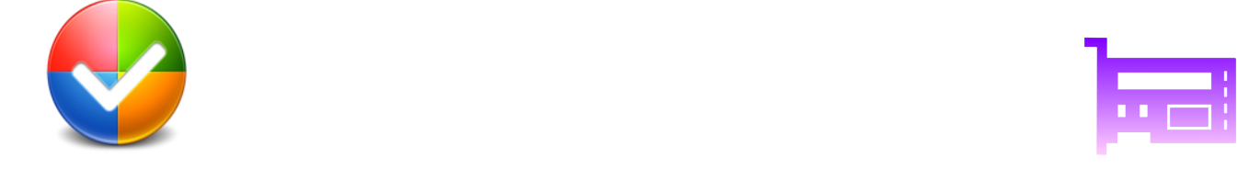
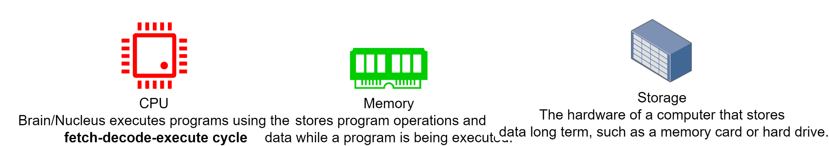
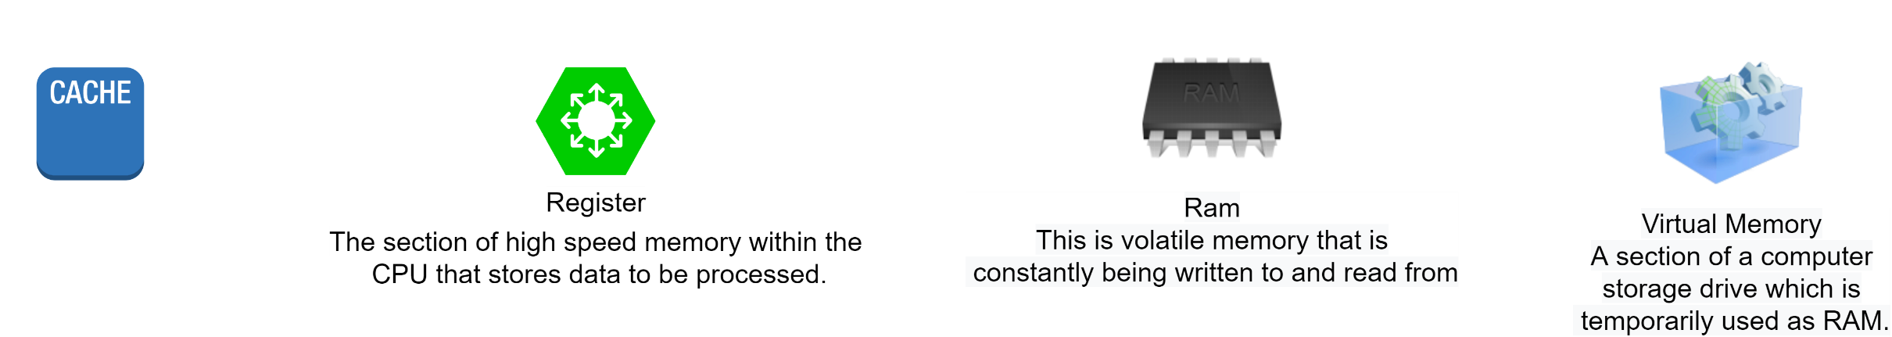


program
Concurrency In JAVA
Processing Components
01
SOFTWARE
HARDWARE
CPU
Memory
Storage
RAM
Virtual Memory
Cache
Register
Stack
Heap
BUILDING BRAINSTORM @ 221B BAKER STREET
Email: visual.learn@gmail.com
Ph no: +91 8334949911.

Slide 11


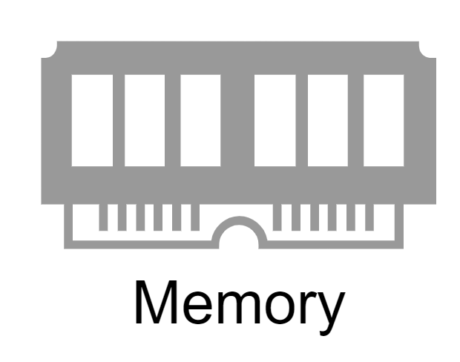
03
20 years back there was Two Major component for processing data
CPU
Memory
CPU was directly reading everything from memory
Legacy Computation
Memory Speed<< CPU processing speed
Visual Learn-A Learning CAFE
BUILDING BRAINSTORM @ 221B BAKER STREET
03
In that time CPU were directly reading elements from Memory

Slide 12







03
Modern Computation CPU replicate Data either Cache or Register for first processing.
The replication will be happened at At CPU or register it depends on Java Virtual machine or Instructions which this one executing
Modern Computation
Visual Learn-A Learning CAFE
BUILDING BRAINSTORM @ 221B BAKER STREET
03
In that time CPU were directly reading elements from Memory

Slide 13




03
There for situation can happen that some changes happen at local cache and before
modification of that happen at shared memory, other process read it, this problem known as cache coherency
Cache Coherncy
CACHE
CPU
CPU
CACHE
Main Memory
Visual Learn-A Learning CAFE
BUILDING BRAINSTORM @ 221B BAKER STREET
03
Computer Memory Speed<< CPU processing speed
If we have lots of CPU but they are not able to access memory first then having that not making much sense.
This Cache Coherycy problem only visible at Distributed Memory System

Slide 14

Social Media Advocacy
if you love us…share it!
Simplilearn is currently running a global social media advocacy campaign called 'Spreading Happiness' and you can be part of it as a “Brand Envoy”.
Notes:
These days Social media is the best platform to interact, so let’s use this platform efficiently to share your happiness with SimpliLearn.

Slide 15
NPS & Feedback for every session you attend
We constantly work on initiatives to ensure that your learning experience is delightful. Enable us to continuously improve
Spare a few seconds after every online class and give us your valuable feedback on :
Trainer
Content
Webex
Get Certified Team
We start working on your feedback right after the session and address it before your next schedule. In our endeavour to understand your concern better, we might try to reach you through email or call.
How likely is it that you would recommend Simplilearn to a friend or colleague?
Net Promoter Score constantly helps us understand our customers’ brand loyalty and any rating less than 9 indicates that your experience was unsatisfactory.
0 1 2 3 4 5 6 7 8 9 10
Notes:
15

